Slide 1

Diabetes Diagnosis Project
This project aims to develop a machine learning model for diagnosing diabetes using a comprehensive dataset of health and demographic information. The team, consisting of Omar Mohamed Ahmed Mashaly, Micheal Mourad, Abdelrahman Zayn, and Mennatullah Ayman, has created a predictive model and user-friendly interface for diabetes risk assessment.
The project encompasses data preprocessing, exploratory data analysis, feature engineering, model development, and deployment. By leveraging a dataset of 100,000 individuals' health records, the team has developed insights and a practical tool for early diabetes diagnosis.

Slide 2



Introduction
IMPORTANCE OF EARLY DIABETES DIAGNOSIS
MACHINE LEARNING FOR DIABETES PREDICTION
PRIORITIZING RECALL AND AUC-PR
Focusing on high recall and AUC-PR metrics to minimize the number of false negatives, ensuring high-risk individuals are correctly identified.
Early diagnosis allows for prompt treatment and management, reducing the risk of complications such as blindness, kidney failure, and cardiovascular disease.
Leveraging health and demographic data to build predictive models that can identify individuals at risk of developing diabetes.
EARLY AND ACCURATE DIABETES DIAGNOSIS IS CRUCIAL FOR EFFECTIVE MANAGEMENT AND PREVENTION OF SERIOUS COMPLICATIONS. BY UTILIZING MACHINE LEARNING MODELS THAT PRIORITIZE KEY PERFORMANCE METRICS, HEALTHCARE PROFESSIONALS CAN MAKE INFORMED DECISIONS AND PROVIDE TIMELY INTERVENTIONS.

Slide 3

Project Overview and Methodology
The project utilizes a dataset from Kaggle, comprising health and demographic data of 100,000 individuals. Key features include age, gender, race, BMI, blood glucose level, HbA1c, hypertension, heart disease, and smoking history.
The methodology involved data preprocessing, including removal of outliers and duplicate entries, handling missing values, and feature engineering. The team created age and BMI category columns and encoded categorical variables for machine learning models.
Data Preprocessing
1
Removal of outliers, handling missing values, feature engineering
2
Exploratory Data Analysis
Analysis of feature correlations, dataset imbalance identification
Model Development
3
Selection and training of machine learning models
4
Deployment
Creation of user-friendly interface for diabetes prediction

Slide 4




Data Preprocessing
ENCODING CATEGORICAL VARIABLES
HANDLING CLASS IMBALANCE
HANDLING MISSING DATA
OUTLIER REMOVAL
Identified missing values in the dataset and implemented strategies like mean/median imputation or dropping rows with missing data to ensure the dataset is complete and ready for further analysis.
Converted categorical variables into numerical formats, such as one-hot encoding or label encoding, to allow the machine learning algorithms to interpret and process the data effectively.
Detected and removed outliers in the dataset using statistical techniques like z-score or Interquartile Range (IQR) to ensure the data is within reasonable bounds and does not skew the model's performance.
The dataset had a significant imbalance between the diabetic and non-diabetic cases. To address this, we used under-sampling, where the majority class (non-diabetic cases) was reduced to match the size of the minority class (diabetic cases). This resulted in a balanced dataset, with both classes having 7,000 samples each, allowing the model to learn from both classes equally.

Slide 5
Key Dataset Insights
The dataset covers years 2015-2022, with a median year of 2019. Age ranges from 0 to 80 years, with a mean of 53 years. About 16.7% of individuals have hypertension, and 9% have heart disease. The mean BMI is 30.10, with values ranging from 10.19 to 88.76.
HbA1c levels range from 3.50 to 9.00, with a median of 6.15. Blood glucose levels range from 80 to 300 mg/dL, with a mean of 163.25 mg/dL. Approximately half of the individuals in the dataset have diabetes.
Age
BMI
Mean: 53 years, Range: 0-80 years
Mean: 30.10, Range: 10.19-88.76
HbA1c
Blood Glucose
Range: 3.50-9.00, Median: 6.15
Mean: 163.25 mg/dL, Range: 80-300 mg/dL

Slide 6
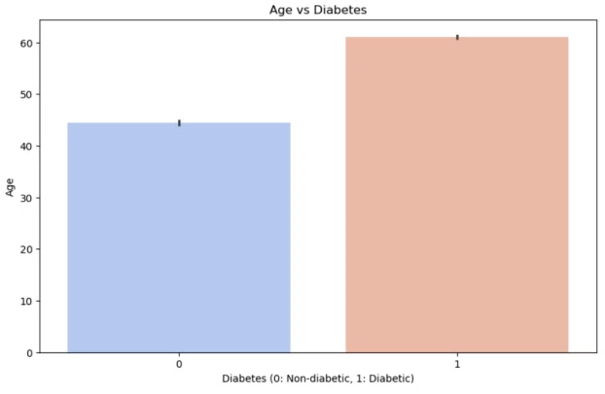
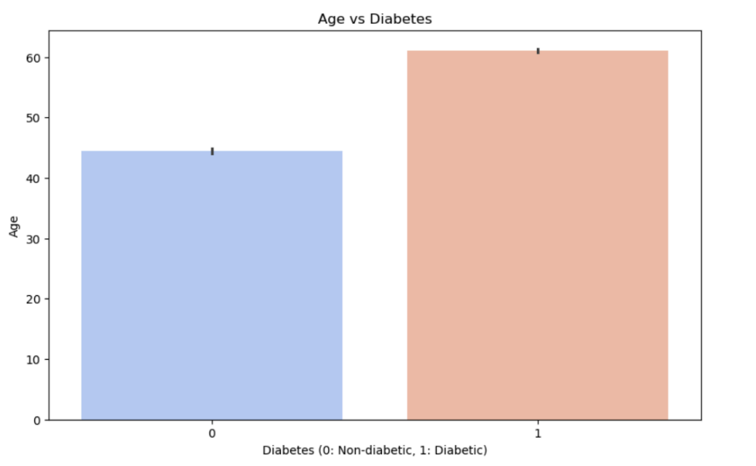
Gender and Age Analysis
The dataset contains more females than males. Among females, most are non-diabetic, but a significant number are diabetic. For males, the trend is reversed, with more being diabetic than non-diabetic.
Age analysis reveals that the average age of non-diabetic individuals is around 45 years, while for diabetic individuals, it's significantly higher at around 60 years. This indicates a clear trend of diabetes being more prevalent in older individuals.
Gender Distribution
Age Analysis
More females than males in dataset
Non-diabetic average: 45 years
Females: Mostly non-diabetic
Diabetic average: 60 years
Males: More diabetic than non-diabetic
Clear trend of higher diabetes prevalence in older individuals

Slide 7
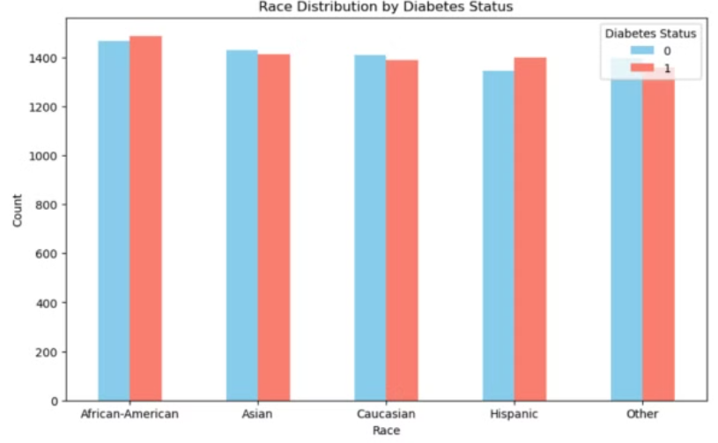
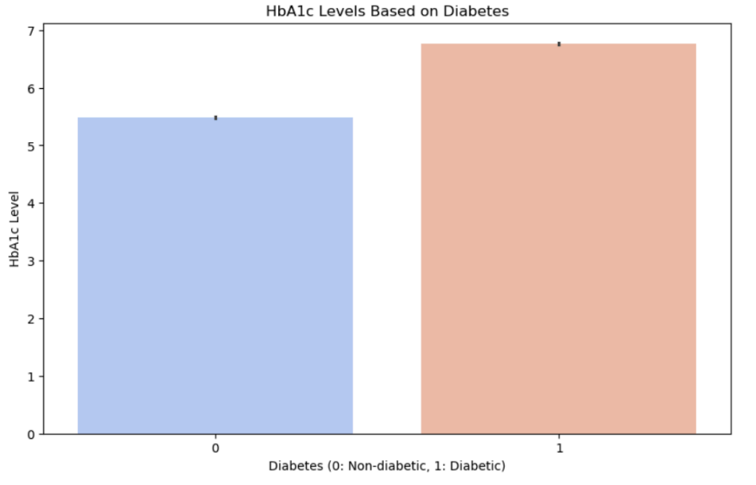
Race and Health Factors Analysis
The dataset shows a balanced representation across racial groups (African-American, Asian, Caucasian, Hispanic, and Other). In all racial categories, there are more non-diabetic individuals than diabetic ones, suggesting relatively consistent diabetes prevalence across races.
Analysis of health factors reveals that diabetic individuals have significantly higher HbA1c levels (around 7) compared to non-diabetics (around 5.5). Hypertension and heart disease are more prevalent among diabetic individuals, indicating a correlation between these conditions and diabetes.
Racial Distribution
Health Factors
Balanced representation across racial groups, consistent diabetes prevalence
Higher HbA1c prevalence in diabetics

Slide 8
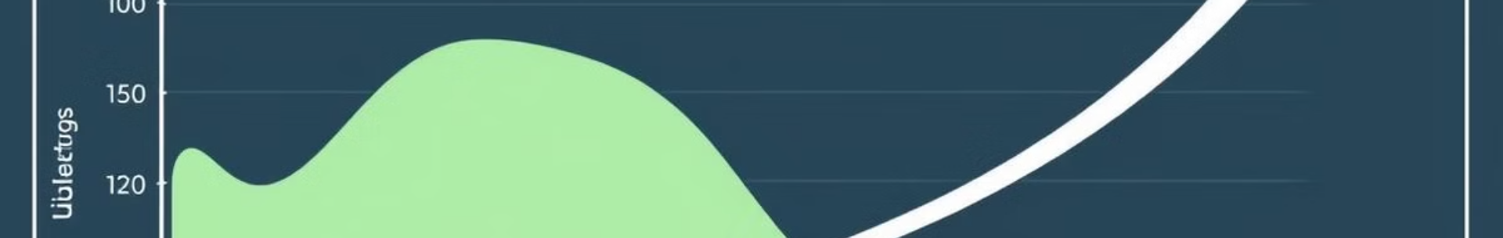



Age Group and BMI Analysis
The analysis shows that diabetes prevalence increases with age, particularly after 40. The 65+ age group has the highest count of diabetic individuals, suggesting this age range is critical for diabetes management and prevention strategies. The non-diabetic count remains nearly stable across age groups.
BMI analysis reveals that the majority of data is concentrated between BMI 20 and 35. Non-diabetic individuals peak around BMI 25, while diabetic individuals peak around BMI 30. This suggests a higher BMI is associated with diabetes, though there is considerable overlap in BMI distributions between both groups.
Young Adults (18-24)
Adults (25-64)
Seniors (65+)
Low diabetes prevalence
Gradual increase in diabetes prevalence
Highest diabetes prevalence

Slide 9

Blood Glucose and HbA1c Analysis
Blood glucose analysis shows a significant peak in frequency for both diabetic and non-diabetic individuals at around 150 mg/dL. However, diabetic individuals have a higher frequency at this level. The non-diabetic group has a more spread-out distribution, with noticeable frequencies at lower glucose levels (around 100 mg/dL).
HbA1c analysis reveals that as BMI increases, there is a noticeable trend where HbA1c levels tend to be higher for those with diabetes. This implies that higher BMI is associated with worse glycemic control in diabetic individuals. There is some overlap in HbA1c levels between the two groups, particularly at lower BMI values.
Group
Average Glucose
HbA1c Trend
Non-diabetic
Lower, stable
Lower, less affected by BMI
Diabetic
Higher, variable
Higher, increases with BMI

Slide 10
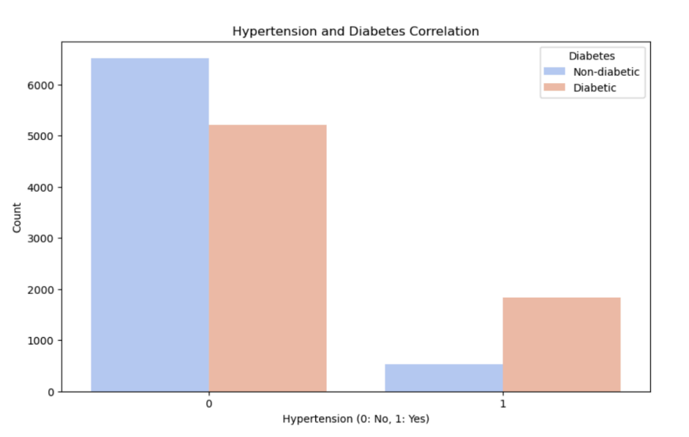

Slide 11
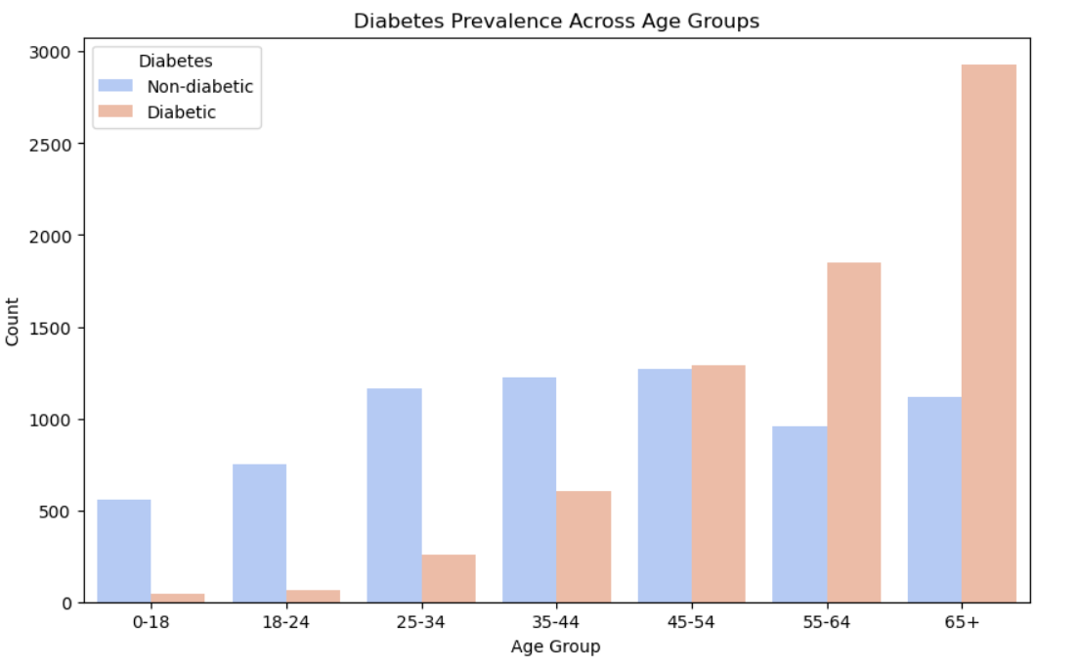

Slide 12
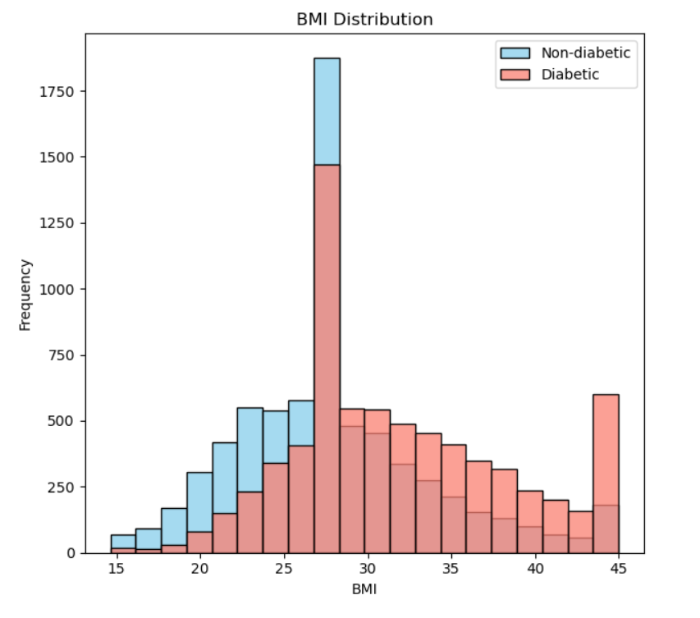
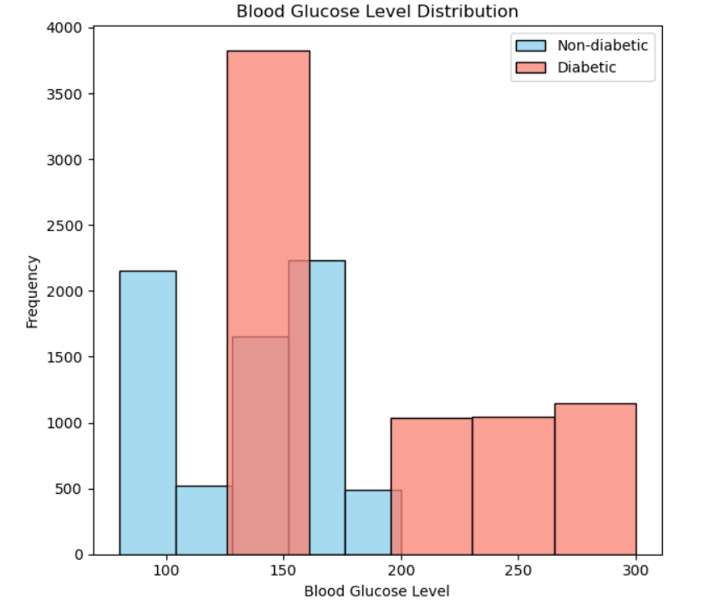

Slide 13
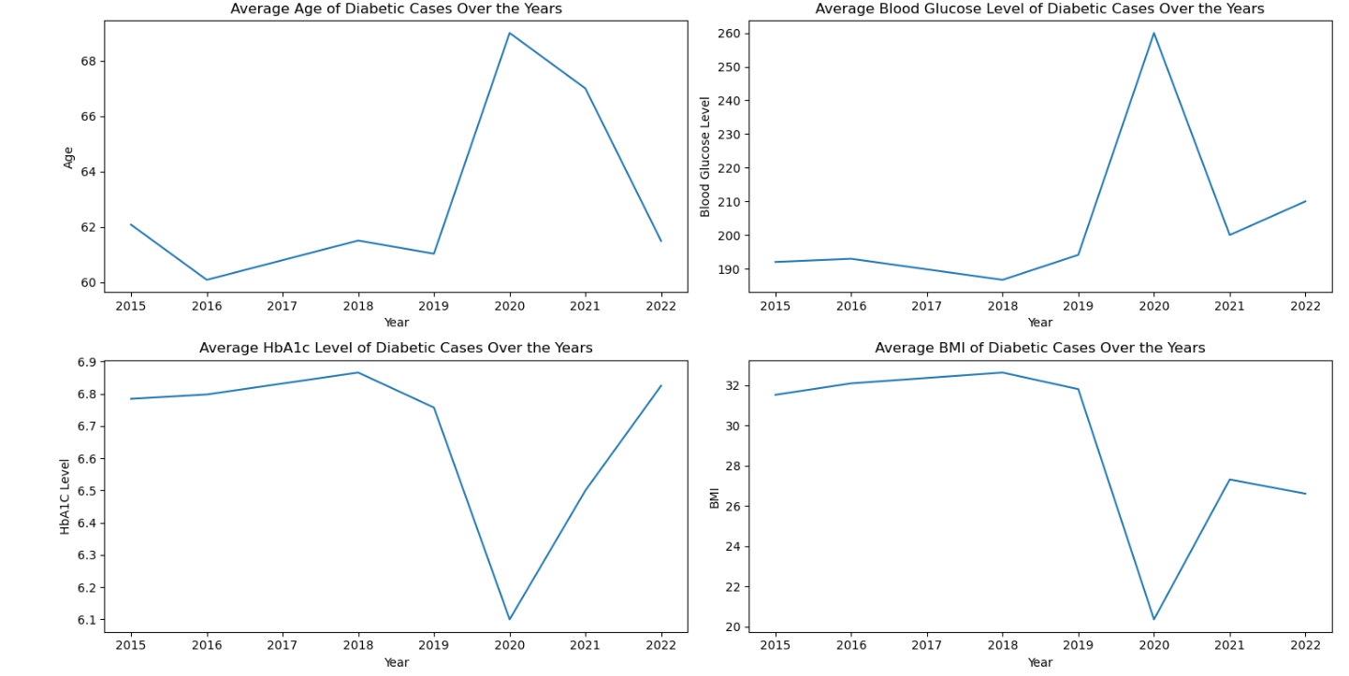

Slide 14
Average Age of Diabetic Cases
Trend: The average age of diabetic cases shows some fluctuations over the years. The average age started around 62 years in 2015, dropped to about 60 years in 2016, then gradually increased, peaking around more than 68 years between 2020 and 2021, before dropping again.
Average Blood Glucose Level of Diabetic Cases
Trend: The average blood glucose level of diabetic cases shows a noticeable spike From 2015 to 2018, the average blood glucose level remained relatively stable around 180-190 mg/dL. However, there was a sharp increase in 2019, peaking at around 260 mg/dL, followed by a decrease in 2020 and 2021, then a slight increase again in 2022.
Average HbA1c Level of Diabetic Cases
Trend: The average HbA1c level also shows fluctuations over the years. The average HbA1c level was relatively stable from 2015 to 2017 around 6.8%. It then showed some variations, with a peak in 2018 and a dip in 2020, followed by another peak in 2022.
Average BMI of Diabetic Cases
Trend: the average BMI of diabetic individuals remained relatively stable, around 31, until 2019,
after which it began to steadily decline, dropping significantly between 2020 and 2022. This
decrease could suggest that diabetic patients are becoming more health-conscious or that there
are other factors leading to lower BMI in recent years.

Slide 15
Models Implemented
DECISION TREE
A supervised learning algorithm that constructs a tree-like model of decisions based on feature values to make predictions.
RANDOM FOREST
An ensemble learning method that combines multiple decision trees to improve the accuracy and robustness of the model.
XGBOOST
A gradient boosting algorithm that uses a tree-based learning model to provide state-of-the-art performance on a wide range of problems.
GRADIENT BOOSTING
An ensemble learning method that combines multiple weak models (e.g., decision trees) to create a strong predictive model through an iterative process of gradient descent.
LOGISTIC REGRESSION
A statistical model used for binary classification problems, where the goal is to predict the probability of an instance belonging to a particular class.
K-Nearest Neighbors A simple and intuitive algorithm that classifies a data point based on the majority class of its nearest neighbors. It works by finding the 'k' closest data points (neighbors) to the input data and making predictions based on the most common class among those neighbors.
Naive Bayes A probabilistic classifier based on Bayes' Theorem, which assumes that the features are conditionally independent. Despite its simplicity, Naive Bayes is effective for large datasets and is commonly used for text classification and spam filtering.

Slide 16
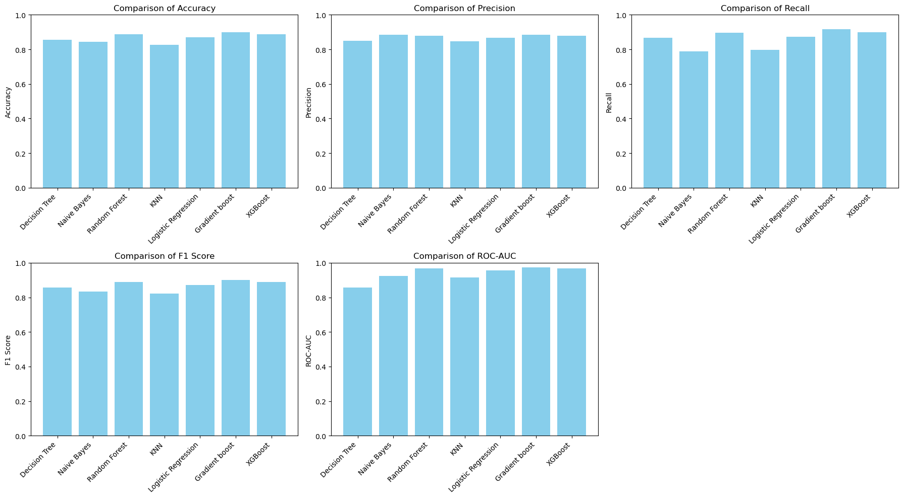
Comparison between metrics according to each model

Slide 17
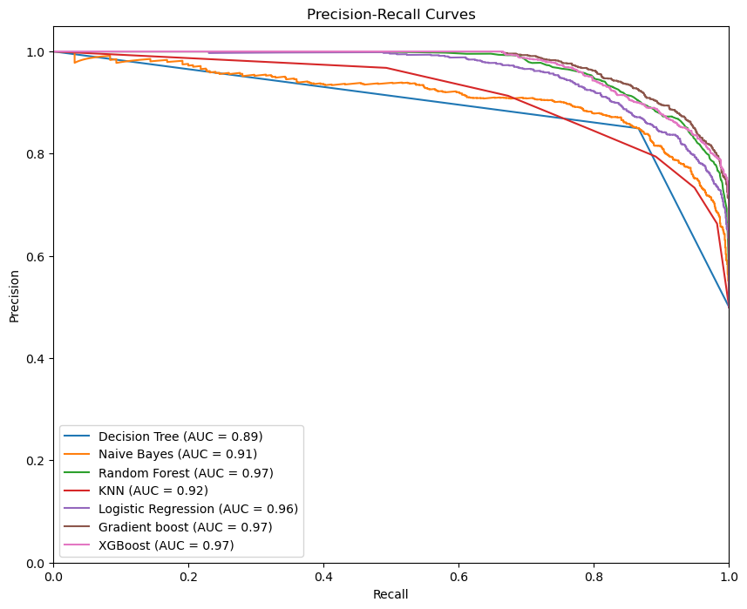
Precision-Recall compassion
AUC-PR: is a measure of the overall performance of a classification model. It is the area under the precision-recall curve, which represents the average precision at different recall levels. A higher AUC-PR indicates better performance. The AUC-PR is a more suitable metric than the AUC-ROC when dealing with imbalanced datasets, where the number of positive and negative examples is significantly different. This is because AUC-ROC can be misleading in such cases, as it may give a high score even if the model performs poorly on the minority class , There is all used Models performance based on this metric

Slide 18



Machine Learning Model Development
After exploring various algorithms, Gradient Boosting was selected as the primary model due to its strong performance, achieving 92% Recall in classifying diabetic and non-diabetic individuals. The model's overall accuracy is 89.89%, with an AUC-PR Score of 97.47%.
Two other models also performed well: XGBoost and Random Forest classifier. The XGBoost model achieved an accuracy of 88.75% and an AUC-PR Score of 97.06%, while the Random Forest Classifier achieved an accuracy of 88.75% and an AUC-PR Score of 96.85%.
Model Accuracy
Recall
AUC-PR Score
Gradient Boosting: 89.89%
Gradient Boosting: 92%
Gradient Boosting: 97.47%

Slide 19
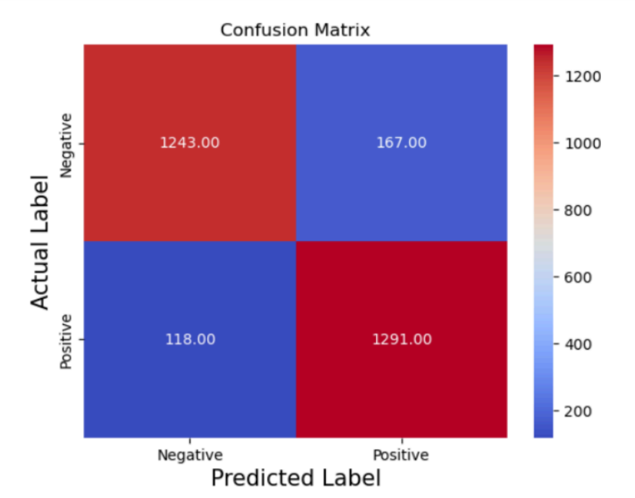

Gradient boosting Confusion Matrix (Best model)
Model Accuracy: 89.89%
AUC-PR Score: 97.47%
Classification Report:
Precision recall f1-score support
0 0.91 0.88 0.90 1410
1 0.89 0.92 0.90 1409

Slide 20
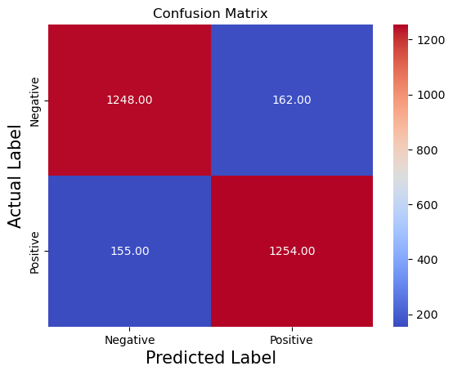

Random Forest Confusion Matrix
Model Accuracy: 88.75%
AUC-PR Score: 96.85%
Classification Report:
precision recall f1-score support
0 0.89 0.89 0.89 1410
1 0.89 0.89 0.89 1409

Slide 21
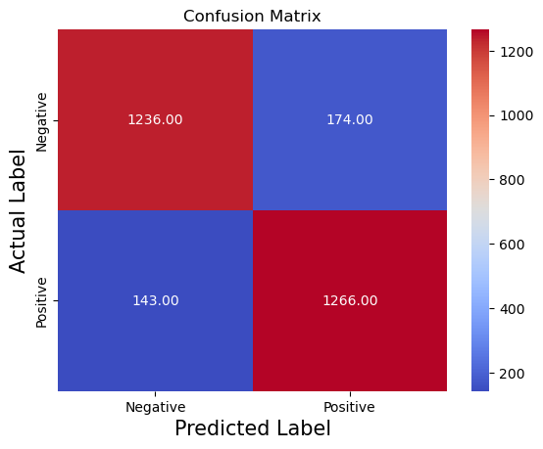

XGBoost Confusion Matrix
Model Accuracy: 88.75%
AUC-PR Score: 97.06%
Classification Report:
precision recall f1-score support
0 0.90 0.88 0.89 1410
1 0.88 0.90 0.89 1409

Slide 22
Application Deployment and Conclusion
The final model was deployed using Streamlit, creating an interactive web application. The app features a Diagnosis Page for users to input health data and receive diabetes risk predictions, and a Visualization Page providing insights into the dataset through visual representations.
This project demonstrates the practical application of machine learning in healthcare, providing a valuable tool for identifying individuals at risk of diabetes. Future improvements may include integrating more complex models, using larger datasets, and incorporating additional health metrics to enhance the accuracy and utility of the diabetes diagnosis tool.
1
Streamlit Deployment
2
Diagnosis Page
Interactive web application for easy access and use
Allows users to input health data for diabetes risk assessment
3
Visualization Page
4
Future Improvements
Provides visual insights into the dataset and model performance
Integration of more complex models and larger datasets

Slide 23
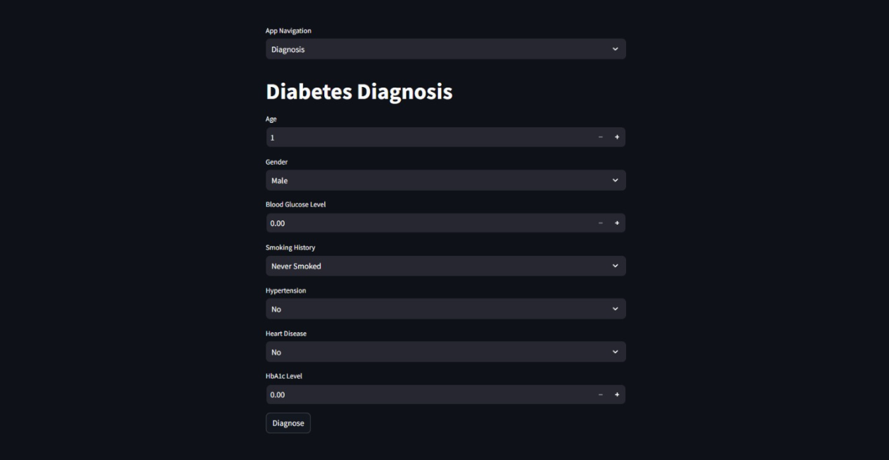

Deployed application
https://diabetes-diagnosis-app.streamlit.app/

